Slide 1

Advance JavaScript
Object Oriented Programming
Lesson - 09

Slide 2
Objective
Add the end of this lesson participants will be able to –
Understand OOP with JavaScript
Create Object using JavaScript
Access the values of JavaScript object

Slide 3
Agenda
Object-Oriented Terminology
Types of Objects
Creating New Types of Objects (Reference Types)
Accessing Object Values / Getter and Setter methods
Prototype paradigm

Slide 4
Object-Oriented Terminology
As per ECMA the object in JavaScript is define as –
The object is an array of values in no particular order.
ECMAScript has no formal classes.
ECMA-262 describes object definitions as the way for an object.
Even though classes don’t actually exist in JavaScript, we will refer to object definitions as classes , as functionally both are same.
Unordered collection of properties each of which contains a primitive value, object, or function.
Notes:
Ecma International is an industry association founded in 1961 and dedicated to the standardization of Information and Communication Technology (ICT) and Consumer Electronics
ECMAScript is the scripting language standardized by Ecma International in the ECMA-262 specification and ISO/IEC 16262. The language is widely used for client-side scripting on the web, in the form of several well-known implementations such as JavaScript, JScript and ActionScript.

Slide 5
Types of Objects
In ECMAScript, all objects are not created equal.
Three specific types of objects can be used and/or created in JavaScript.
Built-in Object
Host Object
Native Objects

Slide 6
Built-in Object
Developer does not require to explicitly instantiate a built-in object; it is already instantiated.
Only two built-in objects are defined by ECMA
Global and
Math
Both are native objects because by definition, every built-in object is a native object

Slide 7
Host Object
Any object that is not native is considered to be a host object, which is defined as an object provided by the host environment of an ECMAScript implementation.
All BOM and DOM objects are considered to be host objects

Slide 8
Native Objects
ECMA defines native objects as -
Native objects are the classes (reference types)
They include all the following:
Object Function Array
String Boolean Number
Date RegExp Error
EvalError RangeError ReferenceError
SyntaxError TypeError URIError
Any object supplied by an ECMAScript implementation independent of the host environment.

Slide 9
Creating New Types of Objects (Reference Types)
JavaScript provides a number of built-in objects.
JavaScript enables developer to create the templates for objects with specification.
The key to this is JavaScript’s support for the definition of reference types.
Reference types are essentially templates for an object.
JavaScript has no formal class construct.
Reference types and classes are the two terms use interchangeably.

Slide 10
Creating New Types of Objects (Reference Types)
A reference type in JavaScript are consists –
A constructor
Method definitions
Properties

Slide 11
Defining a Reference Type
Constructor
function Customer (custId, custName, address)
{
this.custId = custId;
this.custName = custName;
this. address = address;
this.bookOrder = function (){
…..
…..
}
}
Properties
Methods

Slide 12
Instantiation
Objects are created by using the new keyword followed by the name of the class to be instantiate -
The parentheses are optional, when the constructor doesn’t require arguments
var obj = new Object();
var str = new String();
var obj = new Object;
var str = new String;

Slide 13
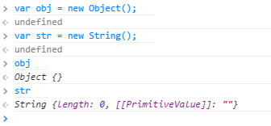
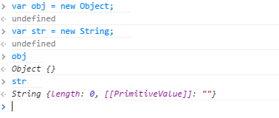
Declaration and instantiation ( Contd.)

Slide 14
Objects in JavaScript
In JavaScript objects are also associative arrays (or) hashes (key value pairs).
Assign keys with obj[key] = value or obj.name = value
Remove keys with delete obj.name
Iterate over keys with for(key in obj), iteration order for string keys is always in definition order, for numeric keys it may change.
Properties, which are functions, can be called as obj.method(). They can refer to the object as this. Properties can be assigned and removed any time.
A function can create new objects when run in constructor mode as new Func(params).
Names of such functions are usually capitalized
Notes:
Add instructor notes here.

Slide 15
Creating objects - Using Constructors
A constructor is a function that instantiates a particular type of Object
new Operator can be used for creating an object using Constructor (predefined/user defined).
Example for User defined Object creation :
Object created using constructor will be reusable.
function Employee(id, name)
{
this.id=id;
this.name=name;
}
var emp1=new Employee(1001,”John");

Slide 16
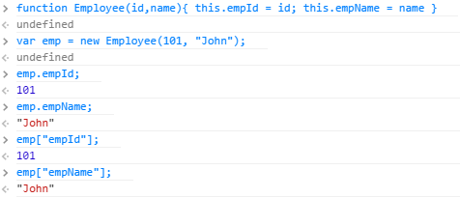
Accessing Object Values
Using dot notation
Using Square Bracket [ Associative array ]

Slide 17
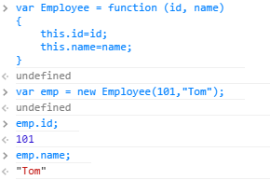
Creating objects - Using Constructors
var Employee = function (id, name)
{
this.id=id;
this.name=name;
}
var emp1=new Employee(101, “Tom");

Slide 18
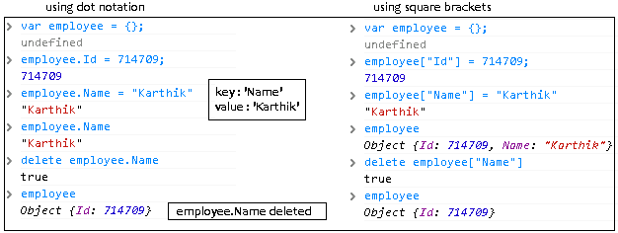
Creating objects
An empty object can be creating using
obj = new Object(); (or) obj = { };
It stores values by key, with that we can assign or delete it using "dot notation" or "Square Brackets" (associative arrays).
Notes:
Add instructor notes here.

Slide 19
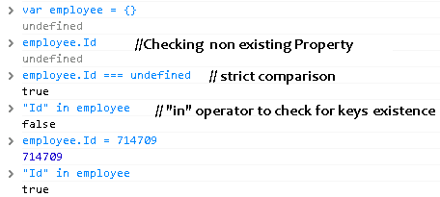
Checking for non existing property in object
If the property does not exist in the object , then undefined is returned
To check whether key existence we can use in operator
Notes:
Add instructor notes here.

Slide 20
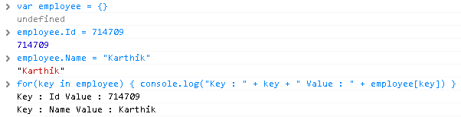
Iterating over object keys
We can iterate over keys using for .. In
Notes:
Add instructor notes here.

Slide 21
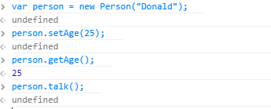
Getter/Setter Methods
function Person(name) {
var age; //Define a private member
this.name = name; //Define a public variable
this.talk = function() { // Define a method
alert( "My name is " + this.name)
}
this.setAge = function(argAge){
age = argAge;
}
this.getAge = function(){
return age;
} }

Slide 22
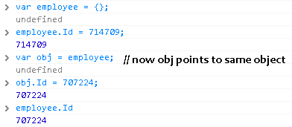
Object reference
A variable which is assigned to object actually keeps reference to it.
It acts like a pointer which points to the real data. Using reference variable we can change the properties of object.
Variable is actually a reference, not a value when we pass an object to a function.
Notes:
Add instructor notes here.

Slide 23
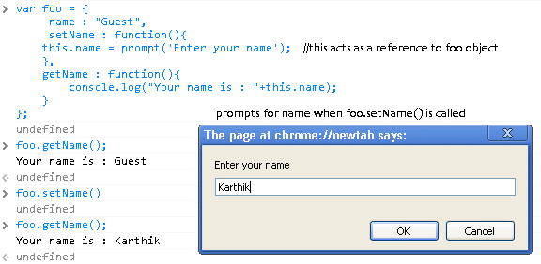
this keyword
When a function is called from the object, this becomes a reference to this object.
Notes:
Add instructor notes here.

Slide 24
Prototype paradigm
Prototype paradigm makes use of an object’s prototype property, which is considered to be the prototype upon which new objects of that type are created.
In Prototype , an empty constructor is used only to set up the name of the class.
All properties and methods are assigned directly to the prototype property.

Slide 25
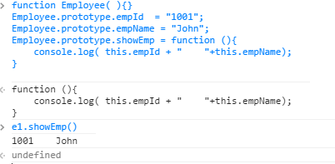
Prototype paradigm
function Employee( ){ }
Employee.prototype.empId = “1001”;
Employee.prototype.empName = “John”;
Employee.prototype.showEmp = function (){
console.log( this.empId + “ “+this.empName);
}
var e1 = new Employee();
var e2 = new Employee();

Slide 26
Summary
In this lesson we have learned about -
Object-Oriented concept with JavaScript
Types of Objects
How to Create New Types of Objects
How to Access Object Values
How to create Getter and Setter methods
Prototype paradigm

